Slide 1

Commonwealth Bank SQL Project (Window Functions)
Michael Le

Slide 2
Requirements
Install and Download SQL Server Express (2022,or 2025 (much preferred)) from Microsoft
Files and sources from my repository:
https://github.com/Mikele02171/Main-Stuff/tree/main/DA%20Bootcamp%202026%20Emergi%20Mentors/Week%202%20SQL%20Mastery/Module%204%20Advanced%20SQL%20and%20Enterprise%20Analytics/Window_Functions_Mastery

Slide 3
Content
Add Commonwealth Bank Database
DDL: Creating Customers Table
DML: Inserting Customer Data
DQL: Validation Check
DQL: Overall Customer Transaction Aggregations
DQL: Customer Transaction Details
DQL: Customer Rank based on Customer Balance
DQL: Rank vs Dense Rank on Customer Balance
DQL: Percentiles on Customer Balance
DQL: LAG and LEAD on Customer Balances
DQL: Year-over-Year Comparison
DQL: Running Totals with SUM(), OVER()
DQL: Calculate rankings for each state
DQL: Production Dashboard Query
DQL: Top Customers per State
DQL: Month-over-Month Signup Growth
DQL: Moving Average
DQL: Percentile Rank
DQL: First and Last Values

Slide 4
Add Commonwealth Bank Database
-- First, switch to master to avoid "currently in use" errors
USE master;
GO
-- Drop database if exists (fresh start)
IF EXISTS (SELECT name FROM sys.databases WHERE name = 'Commonwealth_Bank')
BEGIN
PRINT 'Dropping existing Commonwealth_Bank database...';
ALTER DATABASE Commonwealth_Bank SET SINGLE_USER WITH ROLLBACK IMMEDIATE;
DROP DATABASE Commonwealth_Bank;
PRINT '✅ Existing database dropped successfully';
END
GO
-- Create fresh database
CREATE DATABASE Commonwealth_Bank;
GO
USE Commonwealth_Bank;
GO

Slide 5
DDL: Creating Customers Table
CREATE TABLE customers (
customer_id INT PRIMARY KEY,
customer_name NVARCHAR(100),
state NVARCHAR(10),
city NVARCHAR(50),
account_type NVARCHAR(30),
signup_date DATE,
current_balance DECIMAL(15,2),
balance_2023 DECIMAL(15,2), -- For YoY comparison
balance_2024 DECIMAL(15,2)
);

Slide 6
DML: Inserting Customer Data Part 1
INSERT INTO customers VALUES
-- High-value NSW customers
(1001, 'Sarah Mitchell', 'NSW', 'Sydney', 'Premium Savings', '2022-01-15', 485000.00, 420000.00, 485000.00),
(1002, 'James Chen', 'NSW', 'Sydney', 'Investment Account', '2021-06-20', 750000.00, 680000.00, 750000.00),
(1003, 'Emma Thompson', 'NSW', 'Newcastle', 'Premium Savings', '2023-03-10', 125000.00, 0.00, 125000.00),
(1004, 'Liam O''Connor', 'NSW', 'Wollongong', 'Standard Savings', '2022-08-15', 68000.00, 55000.00, 68000.00),
(1005, 'Olivia Patel', 'NSW', 'Parramatta', 'Premium Savings', '2021-11-20', 320000.00, 280000.00, 320000.00),
-- High-value VIC customers
(1006, 'William Zhang', 'VIC', 'Melbourne', 'Investment Account', '2020-05-10', 890000.00, 820000.00, 890000.00),
(1007, 'Ava Nguyen', 'VIC', 'Melbourne', 'Premium Savings', '2022-02-28', 425000.00, 360000.00, 425000.00),
(1008, 'Noah Williams', 'VIC', 'Geelong', 'Standard Savings', '2023-07-15', 95000.00, 0.00, 95000.00),
(1009, 'Isabella Brown', 'VIC', 'Carlton', 'Premium Savings', '2021-09-05', 510000.00, 470000.00, 510000.00),
(1010, 'Mason Taylor', 'VIC', 'Richmond', 'Investment Account', '2020-12-12', 670000.00, 610000.00, 670000.00),
-- QLD customers (mix of high and mid-value)
(1011, 'Sophia Anderson', 'QLD', 'Brisbane', 'Premium Savings', '2022-04-20', 380000.00, 330000.00, 380000.00),
(1012, 'Lucas Martin', 'QLD', 'Gold Coast', 'Standard Savings', '2023-05-18', 82000.00, 0.00, 82000.00),
(1013, 'Charlotte Garcia', 'QLD', 'Cairns', 'Premium Savings', '2021-10-10', 240000.00, 215000.00, 240000.00),
(1014, 'Ethan Rodriguez', 'QLD', 'Townsville', 'Standard Savings', '2022-11-25', 105000.00, 88000.00, 105000.00),
(1015, 'Amelia Lee', 'QLD', 'Brisbane', 'Investment Account', '2020-08-15', 625000.00, 570000.00, 625000.00),
(1024, 'Grace Wilson', 'NSW', 'Newcastle', 'Premium Savings', '2022-08-11', 485000.00, 420000.00, 485000.00), -- TIE with Sarah
(1025, 'Oscar Brown', 'VIC', 'Geelong', 'Premium Savings', '2022-09-25', 240000.00, 215000.00, 240000.00); -- TIE with Charlotte

Slide 7
DML: Inserting Customer Data Part 2
-- WA and SA customers
(1016, 'Benjamin Kim', 'WA', 'Perth', 'Premium Savings', '2021-03-12', 355000.00, 310000.00, 355000.00),
(1017, 'Harper Singh', 'WA', 'Fremantle', 'Investment Account', '2022-07-08', 540000.00, 490000.00, 540000.00),
(1018, 'Evelyn Tran', 'SA', 'Adelaide', 'Premium Savings', '2023-01-20', 145000.00, 0.00, 145000.00),
(1019, 'Alexander Liu', 'SA', 'Adelaide', 'Standard Savings', '2022-09-14', 78000.00, 62000.00, 78000.00),
(1020, 'Mia Johnson', 'SA', 'Adelaide', 'Premium Savings', '2021-12-05', 290000.00, 255000.00, 290000.00),
-- Additional customers with IDENTICAL balances to create TIES (demonstrates RANK vs DENSE_RANK)
(1021, 'Daniel Cooper', 'NSW', 'Sydney', 'Premium Savings', '2022-03-18', 320000.00, 280000.00, 320000.00), -- TIE with Olivia
(1022, 'Sophie Taylor', 'VIC', 'Melbourne', 'Premium Savings', '2022-05-22', 380000.00, 330000.00, 380000.00), -- TIE with Sophia
(1023, 'Ryan Martinez', 'QLD', 'Brisbane', 'Premium Savings', '2022-06-30', 290000.00, 255000.00, 290000.00), -- TIE with Mia
(1024, 'Grace Wilson', 'NSW', 'Newcastle', 'Premium Savings', '2022-08-11', 485000.00, 420000.00, 485000.00), -- TIE with Sarah
(1025, 'Oscar Brown', 'VIC', 'Geelong', 'Premium Savings', '2022-09-25', 240000.00, 215000.00, 240000.00); -- TIE with Charlotte

Slide 8

DQL: Validation Check
SELECT
COUNT(*) AS total_customers,
MIN(current_balance) AS min_balance,
MAX(current_balance) AS max_balance,
ROUND(AVG(current_balance), 2) AS avg_balance,
SUM(current_balance) / 1000000 AS total_deposits_millions
FROM customers;
GO

Slide 9

DQL: Overall Customer Transaction Aggregations
SELECT
AVG(current_balance) AS average_balance,
COUNT(*) AS total_customers,
SUM(current_balance) AS total_deposits
FROM customers;

Slide 10
DQL: Customer Transaction Details
SELECT
customer_name,
state,
current_balance,
AVG(current_balance) OVER () AS average_balance,
ROUND(current_balance - AVG(current_balance) OVER (), 2) AS difference_from_avg,
CASE
WHEN current_balance > AVG(current_balance) OVER () THEN 'Above Average'
ELSE 'Below Average'
END AS performance
FROM customers
ORDER BY current_balance DESC;

Slide 11
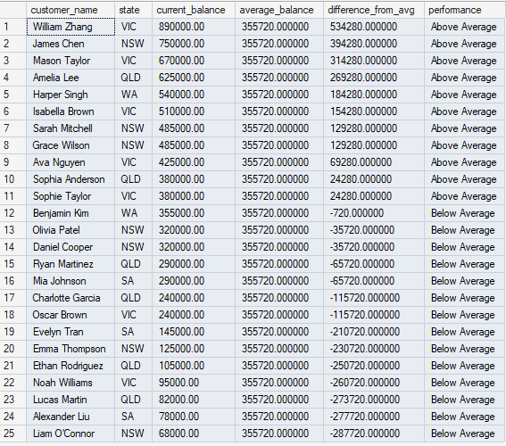

Slide 12
DQL: Customer Rank based on Customer Balance
SELECT
ROW_NUMBER() OVER (ORDER BY current_balance DESC) AS customer_rank,
customer_name,
state,
city,
account_type,
current_balance,
CASE
WHEN ROW_NUMBER() OVER (ORDER BY current_balance DESC) <= 5 THEN 'VIP Customer'
WHEN ROW_NUMBER() OVER (ORDER BY current_balance DESC) <= 10 THEN 'Premium Customer'
ELSE 'Standard Customer'
END AS customer_tier
FROM customers
ORDER BY customer_rank;

Slide 13
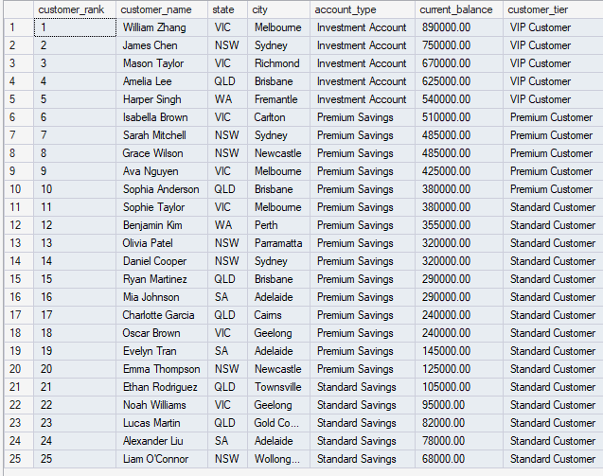

Slide 14
DQL: Rank vs Dense Rank Part 1
PRINT '--- Step 1: Create ties by rounding to nearest $50K ---';
WITH balance_rounded AS (
SELECT
customer_name,
state,
current_balance,
ROUND(current_balance / 50000, 0) * 50000 AS balance_50k -- Round to nearest 50K to create ties
FROM customers
)
SELECT
customer_name,
state,
current_balance AS actual_balance,
balance_50k AS rounded_balance
FROM balance_rounded
ORDER BY balance_50k DESC, current_balance DESC;

Slide 15
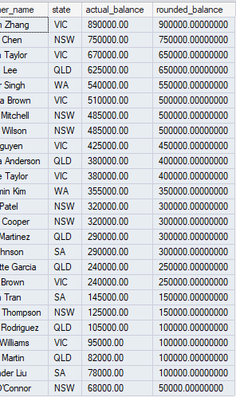

Slide 16
DQL: Rank vs Dense Rank Part 2
WITH balance_rounded AS (
SELECT
customer_name,
state,
current_balance,
ROUND(current_balance / 50000, 0) * 50000 AS balance_50k
FROM customers
)
SELECT
ROW_NUMBER() OVER (ORDER BY balance_50k DESC) AS row_number,
RANK() OVER (ORDER BY balance_50k DESC) AS rank_with_gaps,
DENSE_RANK() OVER (ORDER BY balance_50k DESC) AS dense_rank_no_gaps,
customer_name,
state,
balance_50k AS rounded_to_50k,
current_balance AS actual_balance
FROM balance_rounded
ORDER BY balance_50k DESC, current_balance DESC;

Slide 17
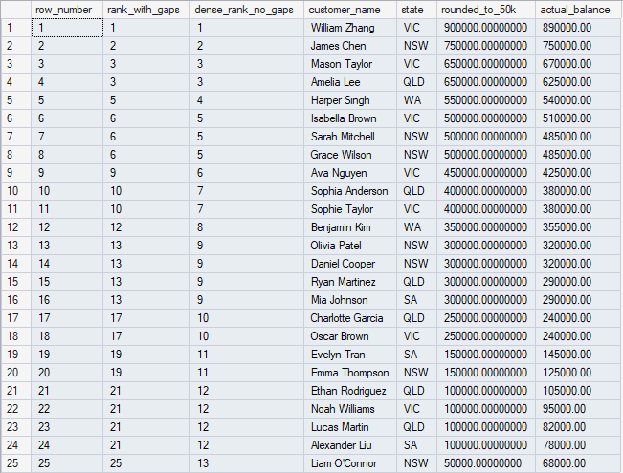

Slide 18
DQL: Percentiles on Customer Balance
SELECT
customer_name,
state,
current_balance,
NTILE(4) OVER (ORDER BY current_balance DESC) AS quartile,
NTILE(10) OVER (ORDER BY current_balance DESC) AS decile,
CASE
WHEN NTILE(4) OVER (ORDER BY current_balance DESC) = 1 THEN 'Top 25% (VIP)'
WHEN NTILE(4) OVER (ORDER BY current_balance DESC) = 2 THEN '25-50% (Premium)'
WHEN NTILE(4) OVER (ORDER BY current_balance DESC) = 3 THEN '50-75% (Standard)'
ELSE 'Bottom 25% (Basic)'
END AS customer_segment,
CASE
WHEN NTILE(10) OVER (ORDER BY current_balance DESC) = 1 THEN 'Top 10%'
WHEN NTILE(10) OVER (ORDER BY current_balance DESC) <= 3 THEN 'Top 30%'
WHEN NTILE(10) OVER (ORDER BY current_balance DESC) <= 5 THEN 'Top 50%'
ELSE 'Bottom 50%'
END AS percentile_group
FROM customers
ORDER BY current_balance DESC;

Slide 19
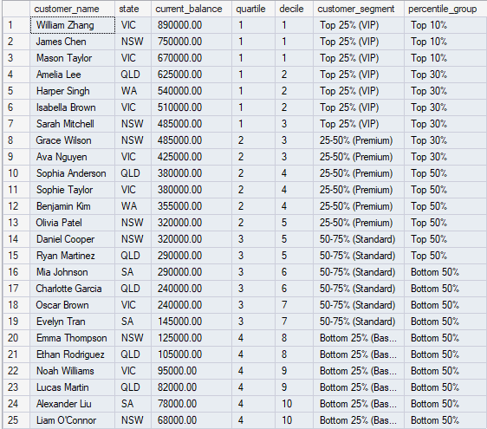

Slide 20
DQL: LAG and LEAD on Customer Balances
SELECT
customer_name,
signup_date,
current_balance,
LAG(customer_name) OVER (ORDER BY signup_date) AS previous_customer,
LAG(current_balance) OVER (ORDER BY signup_date) AS previous_balance,
LEAD(customer_name) OVER (ORDER BY signup_date) AS next_customer,
ROUND(current_balance - LAG(current_balance) OVER (ORDER BY signup_date), 2) AS balance_diff_from_prev,
DATEDIFF(DAY, LAG(signup_date) OVER (ORDER BY signup_date), signup_date) AS days_since_prev_signup
FROM customers
ORDER BY signup_date;

Slide 21
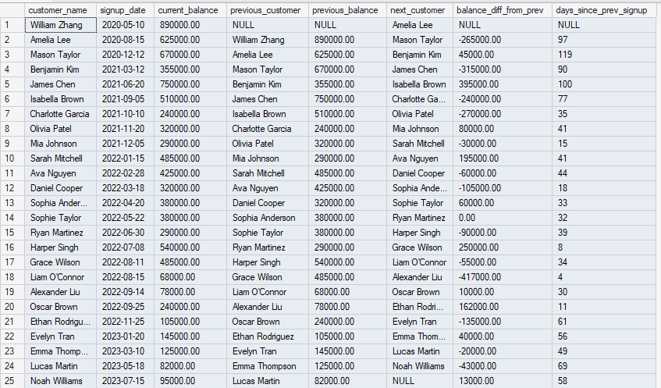

Slide 22
DQL: Year-over-Year Comparison Comparing 2024 balance to 2023 balance for growth analysis
SELECT
customer_name,
state,
account_type,
balance_2023,
balance_2024 AS current_balance,
balance_2024 - balance_2023 AS yoy_growth_amount,
CASE
WHEN balance_2023 > 0
THEN ROUND(((balance_2024 - balance_2023) / balance_2023) * 100, 1)
ELSE NULL
END AS yoy_growth_percent,
CASE
WHEN balance_2024 - balance_2023 > 50000 THEN 'High Growth'
WHEN balance_2024 - balance_2023 > 20000 THEN 'Moderate Growth'
WHEN balance_2024 - balance_2023 > 0 THEN 'Slight Growth'
WHEN balance_2024 = balance_2023 THEN 'No Change'
ELSE 'Decline'
END AS growth_category
FROM customers
WHERE balance_2023 > 0 -- Only customers who existed in 2023
ORDER BY yoy_growth_percent DESC;

Slide 23
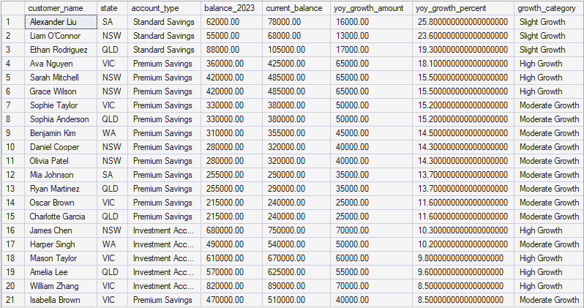

Slide 24
DQL: Running Totals with SUM(), OVER() Cumulative deposit growth as customers signed up
SELECT
customer_name,
signup_date,
current_balance,
SUM(current_balance) OVER (ORDER BY signup_date) AS running_total,
ROUND(SUM(current_balance) OVER (ORDER BY signup_date) / 1000000, 2) AS running_total_millions,
ROUND((SUM(current_balance) OVER (ORDER BY signup_date) /
(SELECT SUM(current_balance) FROM customers)) * 100, 1) AS percent_of_total
FROM customers
ORDER BY signup_date;

Slide 25
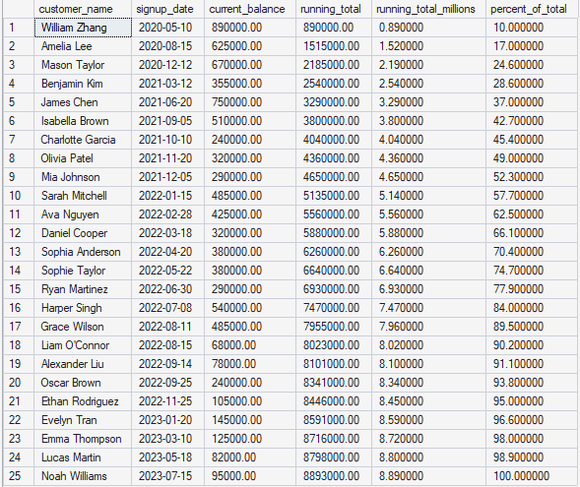

Slide 26
DQL: Calculate rankings for each state
SELECT
state,
customer_name,
current_balance,
-- Overall rank (across all states)
ROW_NUMBER() OVER (ORDER BY current_balance DESC) AS overall_rank,
-- Rank within state only
ROW_NUMBER() OVER (PARTITION BY state ORDER BY current_balance DESC) AS rank_in_state,
-- State statistics
COUNT(*) OVER (PARTITION BY state) AS customers_in_state,
ROUND(AVG(current_balance) OVER (PARTITION BY state), 2) AS state_avg_balance,
-- Comparison to state average
ROUND(current_balance - AVG(current_balance) OVER (PARTITION BY state), 2) AS diff_from_state_avg
FROM customers
ORDER BY state, rank_in_state;

Slide 27
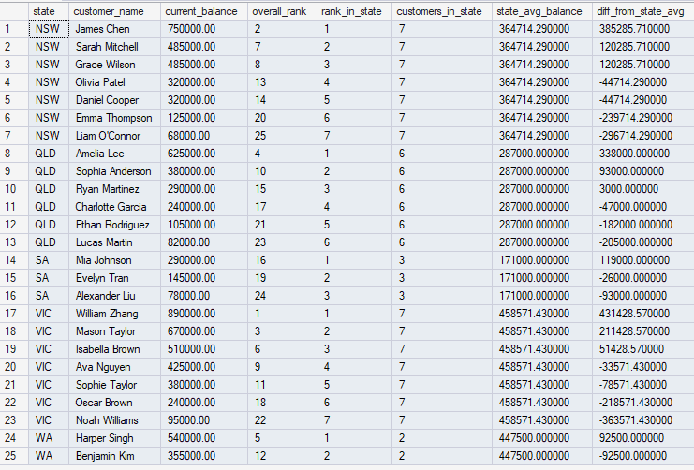

Slide 28
DQL: Production Dashboard Query Part 1
WITH customer_analytics AS (
SELECT
customer_id,
customer_name,
state,
account_type,
signup_date,
current_balance,
balance_2023,
balance_2024,
-- Rankings
ROW_NUMBER() OVER (ORDER BY current_balance DESC) AS overall_rank,
RANK() OVER (ORDER BY current_balance DESC) AS rank_with_ties,
ROW_NUMBER() OVER (PARTITION BY state ORDER BY current_balance DESC) AS state_rank,
-- Percentiles
NTILE(4) OVER (ORDER BY current_balance DESC) AS quartile,
NTILE(10) OVER (ORDER BY current_balance DESC) AS decile,

Slide 29
DQL: Production Dashboard Query Part 2
-- Growth metrics
balance_2024 - balance_2023 AS yoy_growth,
CASE
WHEN balance_2023 > 0
THEN ROUND(((balance_2024 - balance_2023) / balance_2023) * 100, 1)
ELSE NULL
END AS yoy_growth_percent,
-- Running total
SUM(current_balance) OVER (ORDER BY signup_date) AS running_total,
-- State statistics
AVG(current_balance) OVER (PARTITION BY state) AS state_avg_balance,
COUNT(*) OVER (PARTITION BY state) AS state_customer_count
FROM customers
)

Slide 30
DQL: Production Dashboard Query Part 3
SELECT
overall_rank,
customer_name,
state,
account_type,
current_balance,
state_rank,
CASE
WHEN quartile = 1 THEN 'Top 25% (VIP)'
WHEN quartile = 2 THEN '25-50% (Premium)'
WHEN quartile = 3 THEN '50-75% (Standard)'
ELSE 'Bottom 25% (Basic)'
END AS customer_segment,
yoy_growth_percent,
ROUND(running_total / 1000000, 2) AS cumulative_deposits_millions,
ROUND(state_avg_balance, 2) AS state_avg
FROM customer_analytics
ORDER BY overall_rank;

Slide 31
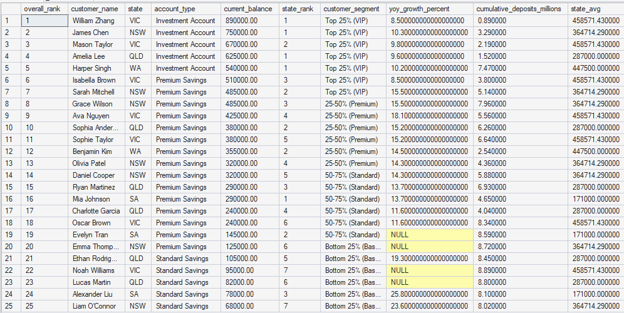

Slide 32
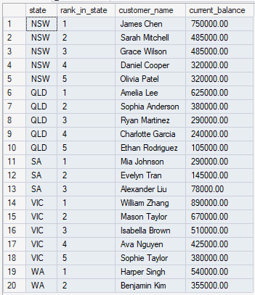
DQL: Top 5 Customers per State
WITH ranked_customers AS (
SELECT
state,
customer_name,
current_balance,
ROW_NUMBER() OVER (PARTITION BY state ORDER BY current_balance DESC) AS rank_in_state
FROM customers
)
SELECT
state,
rank_in_state,
customer_name,
current_balance
FROM ranked_customers
WHERE rank_in_state <= 5
ORDER BY state, rank_in_state;

Slide 33
DQL: Month-over-Month Signup Growth
WITH monthly_signups AS (
SELECT
YEAR(signup_date) AS signup_year,
MONTH(signup_date) AS signup_month,
DATENAME(MONTH, signup_date) AS month_name,
COUNT(*) AS new_customers,
SUM(current_balance) AS total_deposits
FROM customers
GROUP BY YEAR(signup_date), MONTH(signup_date), DATENAME(MONTH, signup_date)
)
SELECT
signup_year,
signup_month,
month_name,
new_customers,
LAG(new_customers) OVER (ORDER BY signup_year, signup_month) AS prev_month_customers,
new_customers - LAG(new_customers) OVER (ORDER BY signup_year, signup_month) AS mom_change,
ROUND(total_deposits / 1000000, 2) AS deposits_millions
FROM monthly_signups
ORDER BY signup_year, signup_month;

Slide 34
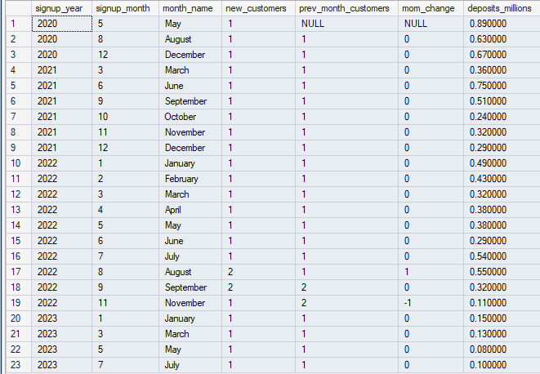

Slide 35
DQL: Moving Average
SELECT
customer_name,
signup_date,
current_balance,
ROUND(AVG(current_balance) OVER (
ORDER BY signup_date
ROWS BETWEEN 2 PRECEDING AND CURRENT ROW
), 2) AS moving_avg_3_customers,
ROUND(current_balance - AVG(current_balance) OVER (
ORDER BY signup_date
ROWS BETWEEN 2 PRECEDING AND CURRENT ROW
), 2) AS diff_from_moving_avg
FROM customers
ORDER BY signup_date;

Slide 36
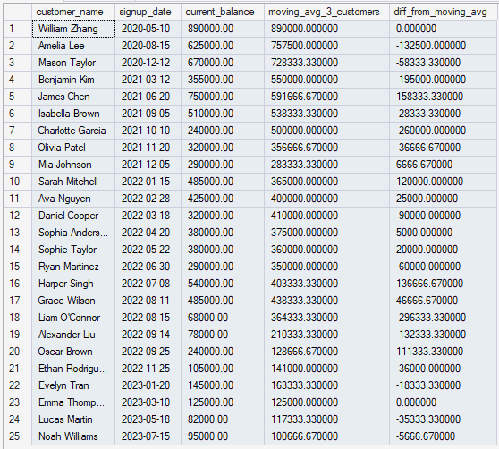

Slide 37
DQL: Percentile Rank
SELECT
customer_name,
current_balance,
ROUND(PERCENT_RANK() OVER (ORDER BY current_balance) * 100, 1) AS percentile_rank,
CASE
WHEN PERCENT_RANK() OVER (ORDER BY current_balance) >= 0.90 THEN 'Top 10%'
WHEN PERCENT_RANK() OVER (ORDER BY current_balance) >= 0.75 THEN 'Top 25%'
WHEN PERCENT_RANK() OVER (ORDER BY current_balance) >= 0.50 THEN 'Top 50%'
ELSE 'Bottom 50%'
END AS percentile_group
FROM customers
ORDER BY current_balance DESC;

Slide 38
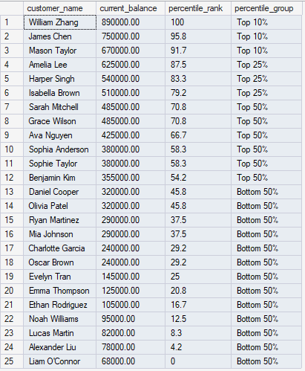

Slide 39
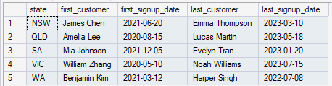
DQL: First and Last Values
SELECT DISTINCT
state,
FIRST_VALUE(customer_name) OVER (
PARTITION BY state ORDER BY signup_date
) AS first_customer,
FIRST_VALUE(signup_date) OVER (
PARTITION BY state ORDER BY signup_date
) AS first_signup_date,
LAST_VALUE(customer_name) OVER (
PARTITION BY state ORDER BY signup_date
ROWS BETWEEN UNBOUNDED PRECEDING AND UNBOUNDED FOLLOWING
) AS last_customer,
LAST_VALUE(signup_date) OVER (
PARTITION BY state ORDER BY signup_date
ROWS BETWEEN UNBOUNDED PRECEDING AND UNBOUNDED FOLLOWING
) AS last_signup_date
FROM customers
ORDER BY state;

